Slide 1
E-Learning Management System
Subtitle: A Comprehensive Online Learning Platform
Presented by: Saima Sultana
Date:

Slide 2
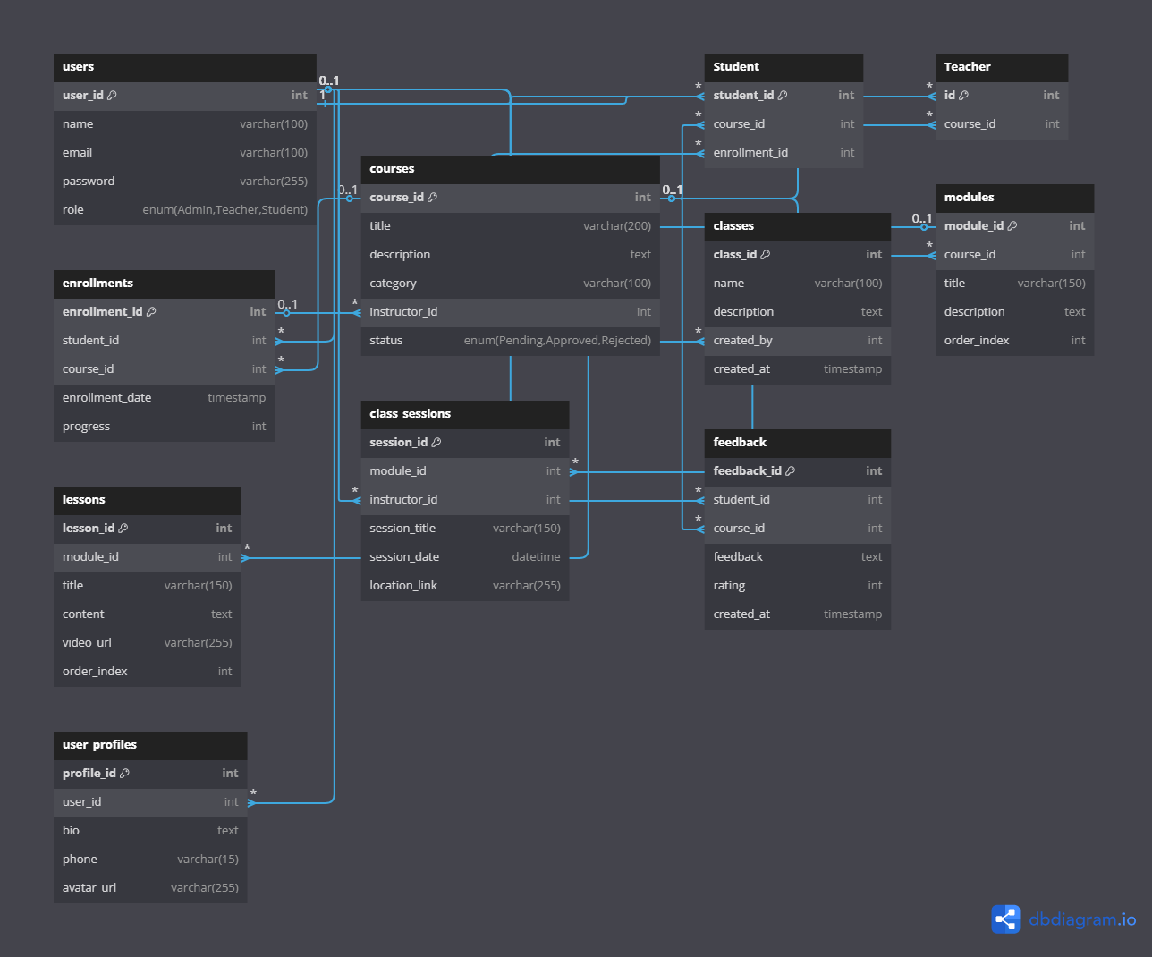
ER DIAGRAM
Notes:
ER DIAGRAM

Slide 3
Project Objective
Objective: To develop a full-fledged E-Learning Management System that provides a seamless platform for students, teachers, and administrators to interact, manage, and track academic content and progress.

Slide 4
Key User Roles
User Authentication & Roles
JWT-based Secure Login
User Roles:
Admin – Full control (users, content, analytics)
Teacher – Course creation and content management
Student – Course browsing, enrollment, learning, feedback

Slide 5
Course Management
Course Listing: Browse available courses by subject/topic
Course Details: Instructor info, syllabus, schedule
Course Enrollment: Enroll, track progress
Content Upload: Lectures, assignments, quizzes

Slide 6
Class Management (Admin)
Add, edit, delete class records
View class details
Manage class schedules and associated instructors/students

Slide 7
Admin Dashboard
Full control over:
Users (approve, delete, modify)
Courses & Lessons (approve/reject)
Profile management
System feedback and analytics

Slide 8
Student Dashboard
Edit/update profile
Enroll/view courses
Submit course feedback
View notifications

Slide 9
Teacher Dashboard
Profile management
Add, edit courses and lessons
View feedback from students
Upload educational materials

Slide 10
Notifications & Alerts
Real-Time Notifications:
New courses, deadlines, announcements
Email Alerts:
Quiz results, class updates, reminders

Slide 11
Technology Stack
Frontend: Angular
Backend: Node.js
Database: PostgreSQL
Authentication: JWT / OAuth2

Slide 12
Summary
All-in-one LMS for Admins, Teachers, and Students
Real-time interaction with academic content
Smooth, role-based access control and course management
Modern, scalable, and secure design

